Slide 1
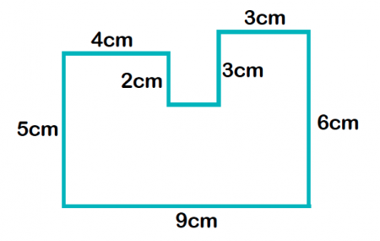
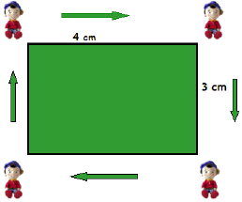
My Measurement Interactive Notebook
Name
Class: 8-
Teacher: Mr Evans
Term 1 Semester 1

Slide 2
Tasks
24
7
30
Essential Question
Questions
Notes
Summary
6

Slide 3
24
7
30
Date
Topic: Area of Kites and Rhombuses
EQ – How do I find the area of a kite and a rhombus?

Slide 4
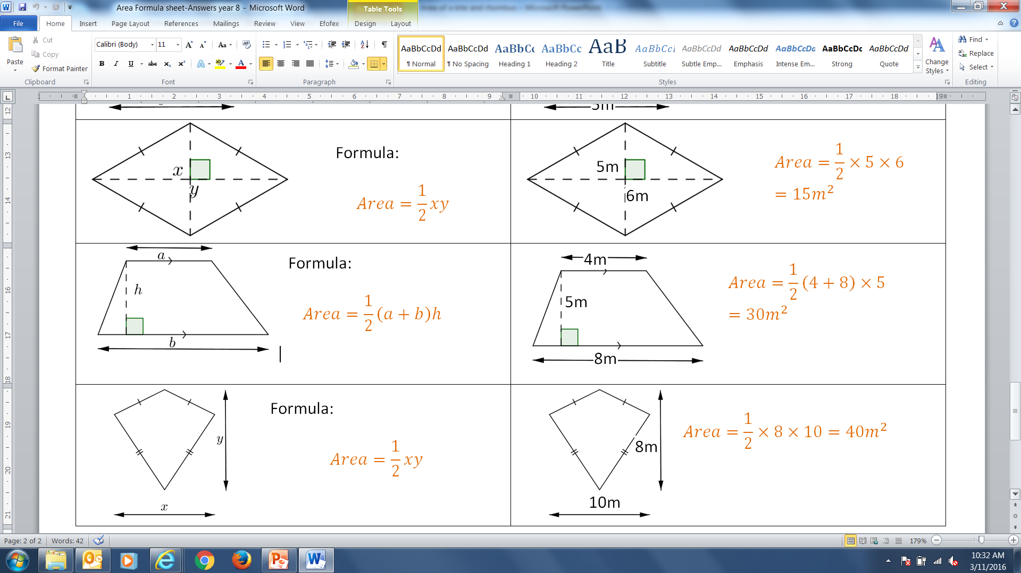
24
7
30
Date
Topic: Area of Kites and Rhombuses
EQ – How do I find the area of a kite?
Kite:
Example:

Slide 5
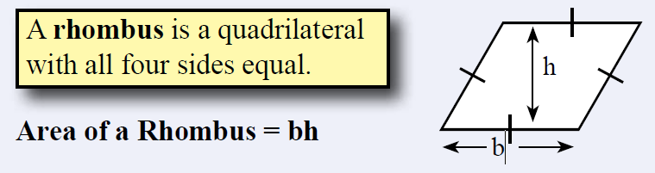
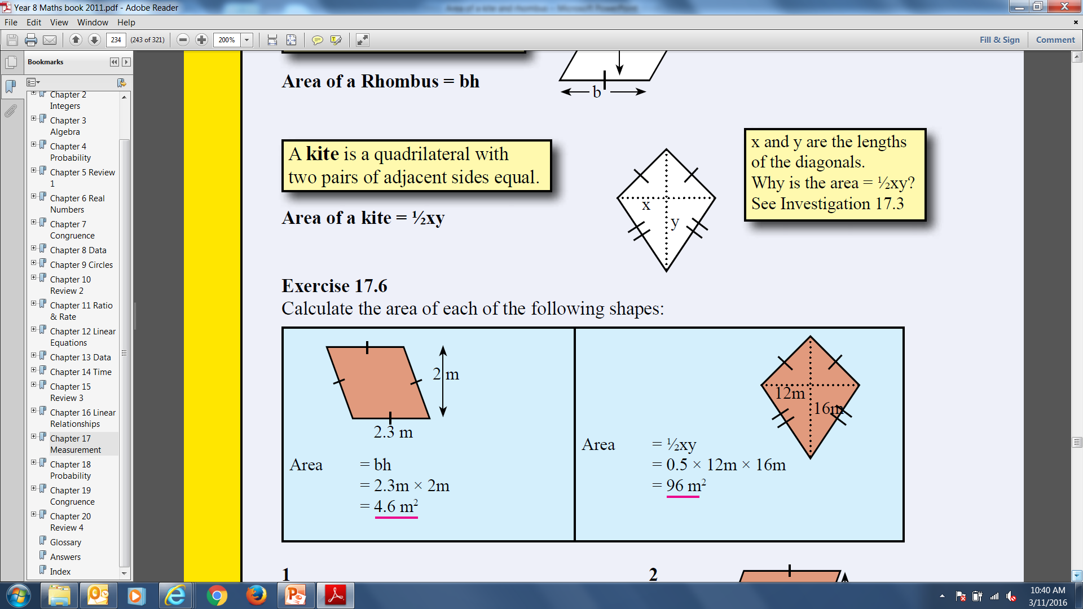
24
7
30
Date
Topic: Area of Kites and Rhombuses
EQ – How do I find the area of a kite?
Rhombus:
Example:

Slide 6
Let’s try some together.
3
4

Slide 7
Your turn.
Now complete the Worksheet.

